Slide 1
data science with python
IDENTIFYING AND UNDERSTANDING GROUPS

Slide 2
IDENTIFYING AND UNDERSTANDING GROUPS

Slide 3
overview
decompose a data set into simpler subsets to help make sense of the entire collection of observations.
groups may reflect different types of observations
different types of customers
demographic information

Slide 4
Ways to group
ways to visualize and group observations
based on similarities of the overall set of variables of interest, as in the case of clustering.
observations that have high values for certain variables may form groups different from those that have low values for the same variables.
identify groups based on interesting combinations of predefined categories - association rules
a rule might be that a group of customers who historically purchased products A, B, and C also purchased product X
Another directed approach, referred to as decision trees, groups observations based on a combination of ranges of continuous variables or of specific categories

Slide 5
clustering
For a given data set it is not necessarily known beforehand what groups of observations the entire data set is composed of
For example, in examining customer data collected from a particular store, it is possible to identify and summarize classes of customers directly from the data to answer questions such as “What types of customers visit the store?”
Clustering is an unsupervised method, labels/targets are not available in the datasets
clustering is used as an open ended way to explore, understand and formulate questions about the data in exploratory data analysis (EDA)
Many clustering methods are available, each have its own use
For clustering, there is no way to measure accuracy and the solution is judged by its “usefulness.”

Slide 6
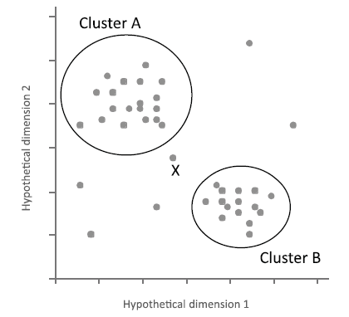
process of clustering
a set of observations are shown on the scatterplot – notice the apparent groups and outliers
Clustering is a flexible approach for grouping.
For example, based on the criteria for clustering the observations, observation X was not determined to be a member of cluster A. However, if a more relaxed criterion was used, X may have been included in cluster A.

Slide 7
Outcome of cluster analysis
Summary of cluster
Data visualization
Naming the clusters
such as the mean or mode values for all selected variables
Series of histogram matrix
Manually naming each cluster can be instructive
customer groups - “Suburban, affluent, and price-sensitive.”
identification of outliers
enable the selection of a smaller number of representatives from the entire data set,

Slide 8
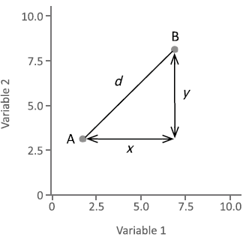
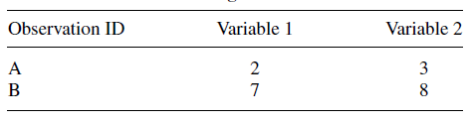

distances
A method of clustering needs a way to measure how similar observations are to each other.
To calculate similarity, we need to compute the distance between observations.
simple example with 2 observations and 2 variables
the physical distance between the two observations by plotting them on the scatterplot

Slide 9
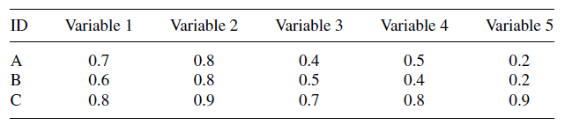
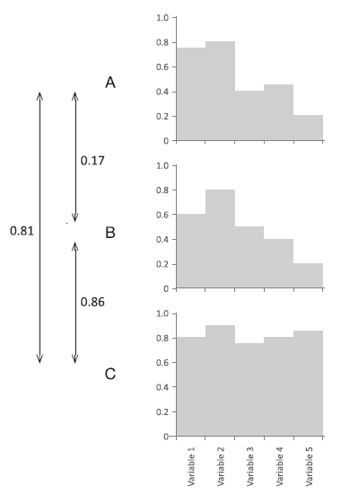
distances
d_{A−B} = 0.17
d_{A−C} = 0.83
d_{B−C} = 0.86
The distance between A and B is 0.17, whereas the distance between A and C is 0.83, which indicates that there is more similarity between observations A and B than A and C
The shape of histograms A and B are similar, whereas the shape of histogram C is not similar to A or B.

Slide 10
DISTANCE MEASURES
5 observations
6 normalized variables
income, age, children, electronic, groceries, clothes
Customer | Income | Age | Children | Electronics | Groceries | Clothes
A | 0.449 | 0 | 0 | 1 | 0.03 | 0
B | 0.051 | 0.6 | 1 | 0 | 1 | 0.89
C | 1 | 1 | 0.67 | 0.29 | 0 | 0
D | 0 | 0.9 | 0.33 | 0.071 | 0.88 | 1
E | 0.6 | 0.25 | 0 | 0.5 | 0 | 0.11
Numeric Distance Measures | Binary Distance Measures | Mixed Variables | Other Measures
Euclidean Square Euclidean Manhattan Maximum Minkowski | Simple matching Jaccard Russell and Rao Dice Rogers and Tanimoto | Gower | Mahalanobis Correlation coefficient Cosine Canberra

Slide 11

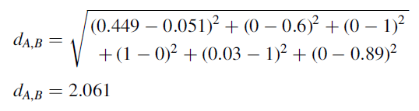
Euclidean
The euclidean distance is one of the most common distance functions.
If a data set only has two variables, then the euclidean distance would calculate the physical distance between the 2 points plotted on a scatterplot.
The following formula calculates a euclidean distance between two observations ( p and q), measured over n variables:
the euclidean distance between observations A and B using the data

Slide 12

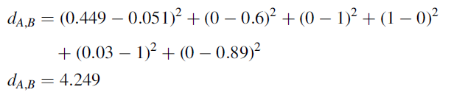
Square Euclidean
The square euclidean is the sum of the squares of the difference between the two observations, and it is calculated using the following formula:

Slide 13

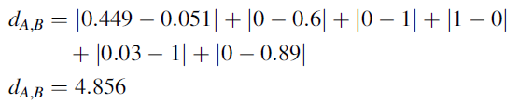
Manhattan
The Manhattan distance, which is also called the city block distance, is the sum of the absolute distances between the variables, which is always a positive value representing the difference.
Calculating the manhattan distance between observations A and B using the data

Slide 14

Maximum
To calculate the maximum distance between two observations, the absolute difference between each variable is determined and the highest difference is selected
The maximum distance between observations A and B, is 1.0, because that is the difference between the values in the variable children (0 minus 1), as well as electronics (1 minus 0).

Slide 15

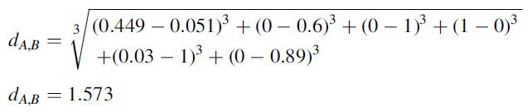
Minkowski
The Minkowski distance is a general distance formula, where the order, or λ can take any positive value.
When λ is œ, the Minkowski distance is the same as the maximum distance.
When λ is 1, the Minkowski distance is the same as the Manhattan distance.
When λ is 2, the Minkowski distance is the same as the Euclidean distance.
The following formula is used to calculate the Minkowski distance:
Minkowski distance between A and B, where λ is equal to 3

Slide 16
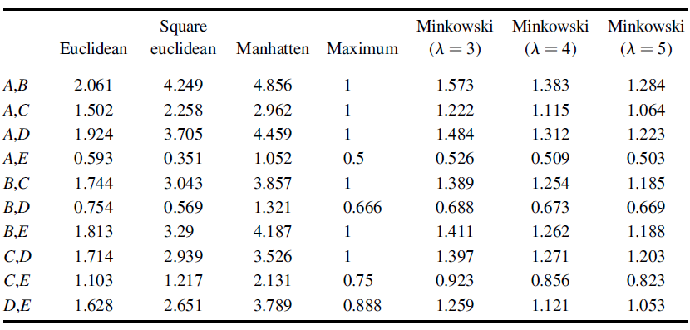
Distances between all Pairs of Observations

Slide 17
Binary Distance Measures
Measures to calculate distances when the observations being compared use all binary variables; that is, variables with values of either 0 or 1.
Similarity measures how alike two observations are to each other, with high similarity values representing situations when the two observations are alike.
This contrasts with distance measures, where low values indicate the observations are alike.
compute
a: the number of variables where the value for both A and B is 1
b: the number of variables where the value for A is 1 and the value for B is 0
c: the number of variables where the value for A is 0 and the value for B is 1
d: the number of variables where the value for both A and B is 0

Slide 18
Sample table
Customer | Urban | Technology | Services | Legal | Female
A | 1 | 1 | 0 | 0 | 0
B | 0 | 0 | 1 | 0 | 1
C | 0 | 0 | 0 | 1 | 1
D | 0 | 0 | 1 | 0 | 1
E | 1 | 1 | 0 | 0 | 0
5 observations
5 binary variables: urban, technology, services, legal, and female.
values for a, b, c, and d for customers B and C are calculated as
a = 1 (female is both 1 in observations B and C)
b = 1 (services is 1 in observation B and 0 in observation C)
c = 1 (legal is 0 in observation B and 1 in observation C)
d = 2 (urban and technology are both 0 in observations B and C)

Slide 19


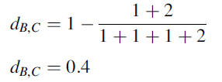
Simple matching
This method calculates the number of common 1 or 0 as a proportion of all variables.
The following formula is used to calculate the similarity coefficients
The corresponding distance calculation is:
the simple distance between B and C is:

Slide 20


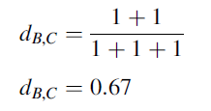
Jaccard
This method calculates the proportion of common ones against the total number of values that are 1 in either or both observations.
the method does not incorporate d (the number of values where the variables are both zero).
The following formula is used to calculate the similarity coefficients
The corresponding distance calculation is:
the Jaccard distance between B and C is:

Slide 21


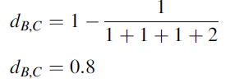
Russell and Rao
This method calculates the proportion of variables where 1 is common in both observations against the total number of variables.
Whereas the Jaccard method disregarded the count for where both values are 0 (d), the Russell and Rao method incorporates it into the calculation.
similarity coefficients
The corresponding distance calculation is:
the Russel and Rao distance between B and C is:

Slide 22


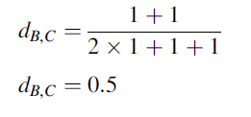
Dice
The Dice method takes into account the number of variables in the two observations which have 1 in common and weighs this against the number of variables with 1 in either or both observations.
This method is similar to Jaccard; however, the Dice formula puts greater emphasis on the common 1 (a).
The following formula is used to calculate the similarity coefficients
The distance formula :
the Dice distance between customer B and C is:

Slide 23


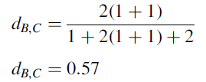
Rogers and Tanimoto
Unlike the methods described above, this method takes into account when both variables have common 0 or 1.
The following formula is used to calculate the similarity coefficients
The corresponding distance calculation is:
the Rogers and Tanimoto distance between B and C is:

Slide 24
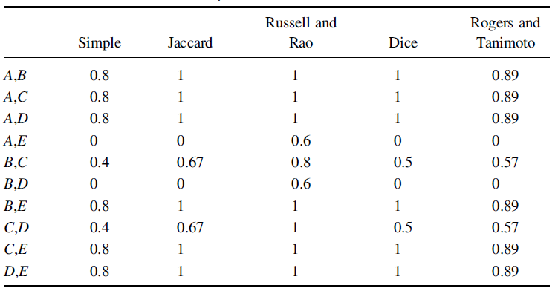
Comparison of Pairs of Distances for 5 Customers Over 5 Binary Distance Measures

Slide 25
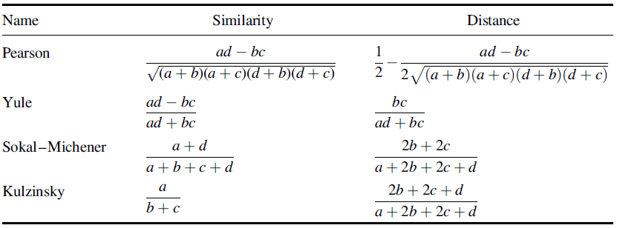
Additional Binary Similarity and Distance Measures

Slide 26
Mixed Variables
Data sets rarely contain solely continuous variables or solely discrete variables, additional methods are needed to cluster data sets that include this mixture of variables.
Customer | Urban | Technology | Services | Legal | Female | Income | Age | Children | Electronics | Groceries | Clothes
A | 1 | 1 | 0 | 0 | 0 | 0.449 | 0 | 0 | 1 | 0.03 | 0
B | 0 | 0 | 1 | 0 | 1 | 0.051 | 0.6 | 1 | 0 | 1 | 0.89
C | 0 | 0 | 0 | 1 | 1 | 1 | 1 | 0.67 | 0.29 | 0 | 0
D | 0 | 0 | 1 | 0 | 1 | 0 | 0.9 | 0.33 | 0.071 | 0.88 | 1
E | 1 | 1 | 0 | 0 | 0 | 0.6 | 0.25 | 0 | 0.5 | 0 | 0.11

Slide 27


gower
The measure is calculated with the following formula for two observations A and B over i variables
where w_{i} is a weight for the i^{th} variable and it takes the value 1 when both values are NOT NULL otherwise it is 0.
d_{i}² is the square of the distance between the ith value of the two observations (A_{i} and B_{i})
R_{i} is the range over all values of the ith variable.
For categorical variables, d_{i} is 0 if the A_{i} and B_{i} are the same, otherwise it is 1.

Slide 28
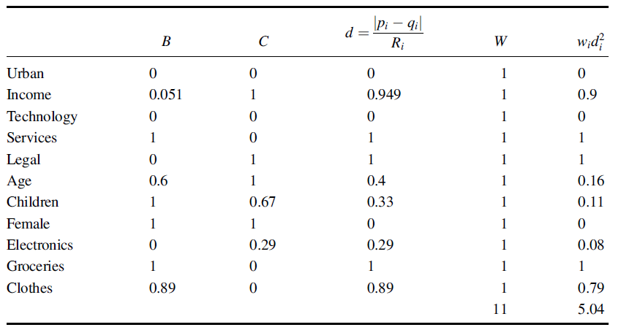
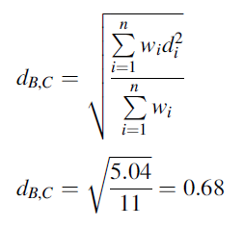
Explanation
observations B and C
Since there are no missing values in any of the observations, the weights (w_{i}) will all be 1

Slide 29
Other Measures
Mahalanobis
correlation coefficients
Cosine
Canberra measures

Slide 30


Mahalanobis
The Mahalanobis distance takes into account correlations within a data set between the variables.
this method is not dependent upon the scale
“-1” → inverse matrix , “T” → transformed matrix
S is the covariance matrix
S_{j,k} are the values in the covariance matrix,
X is the original data table with X_{ij} as the value at column j and row i,
n is the number of observations,
X_{j} is the average for column j
X_{k} is the average for row k.

Slide 31

Correlation coefficient
Using clustering, it is also possible to group variables based on the linear relationship between pairs of variables (r).
Using the following formula, variables x and y can be compared:

Slide 32

Cosine
Using the cosine formula is often effective when clustering vectors of features, such as terms or words that relate to documents, which are often sparse.
The formula for cosine (cs) where p and q represent the observations is:

Slide 33
BUILDING MODELS FROM DATA

Slide 34
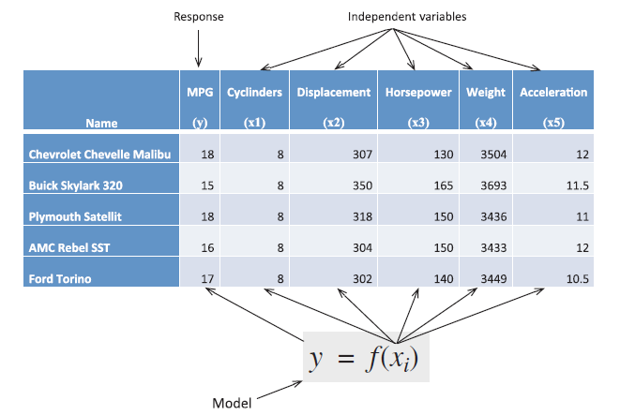
overview
A variable that a model is to predict is often referred to as a y-variable or response variable.
The variables that will be encoded in the model and used in predicting this response are referred to as the x-variables or the independent variables.
E.g. we have chosen the response variable to be miles per gallon (MPG).
Other variables will be used as independent variables (x-variables).
Cylinders (x1), Displacement (x2), Horsepower (x3),Weight (x4), and Acceleration (x5). case is MPG.

